Slide 1
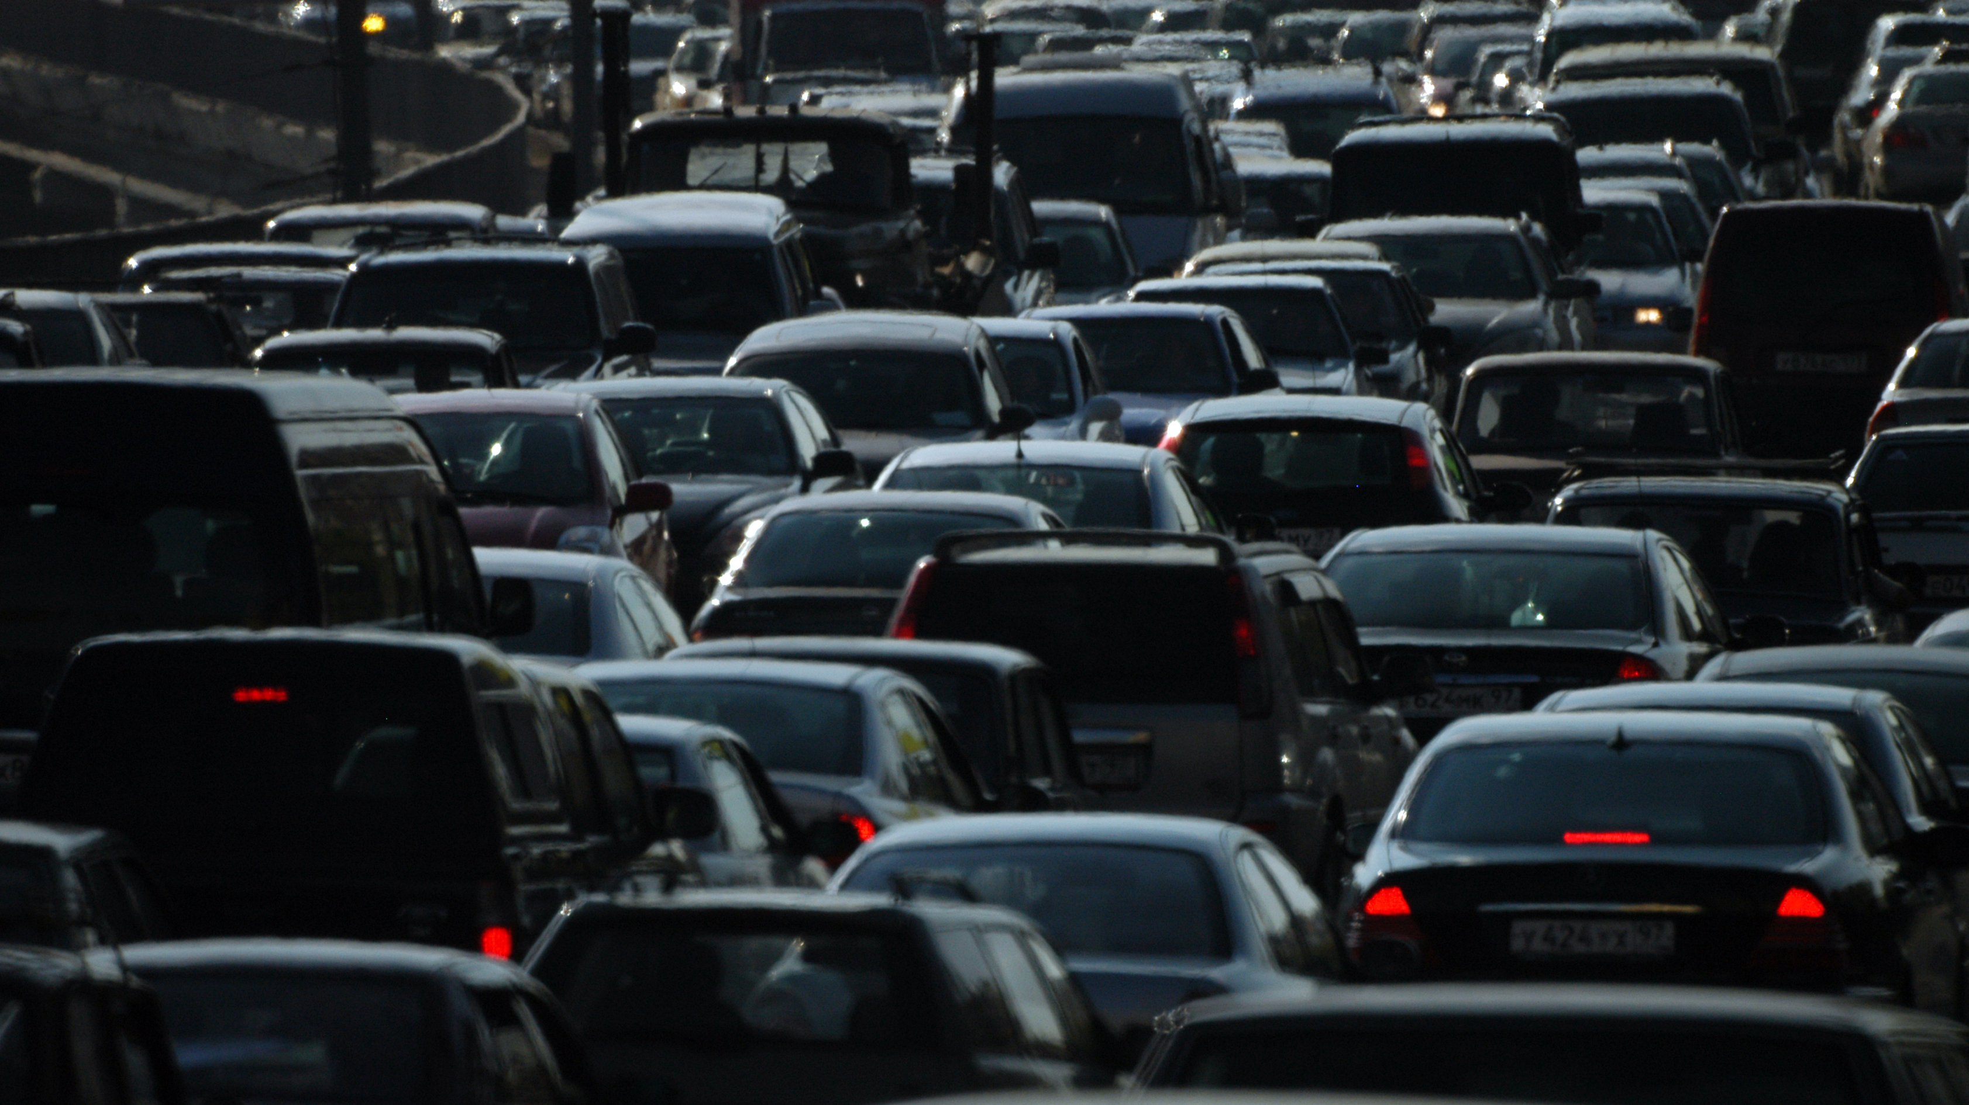
Affordability of 2023 vehicles by median household income
Paris Jones, Matt Jackson, Ranil Joshua, and Lillian Ruelas-Thompson

Slide 2

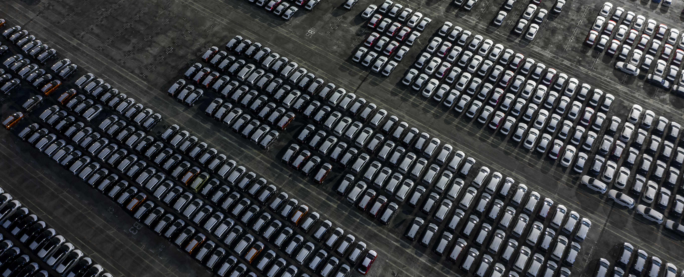

Project Goals and Overview
There are many factors that contribute to the cost of a vehicle, but during and post pandemic, we find that the average cost of a vehicle is affected by the manufacturing supply availability, the United Auto Workers (UAW) Union strike, the lack of inventory, etc. Not only is the cost of a vehicle increasing, but our groceries and gas prices are also rising, with no major change to the minimum wages for Americans, which leaves us wondering how we can afford a new vehicle. We will be taking a dive into the 2020 census data and the data for current 2023 vehicle prices and figure out what types of vehicles the median household can afford.
What is the average median household income for each region?
Will do an analysis of affordability broken down by geographical regions.
What is the average vehicle price for each manufacturer (which make/models)?
Will do an analysis of affordability by vehicle make/model.
Which manufacturer has the most affordable car line/model?
Based on the price of the vehicle, what would the monthly payment be?
Based on the median household income, which vehicles would be affordable assuming the monthly payment is 10% of their gross monthly income?

Slide 3

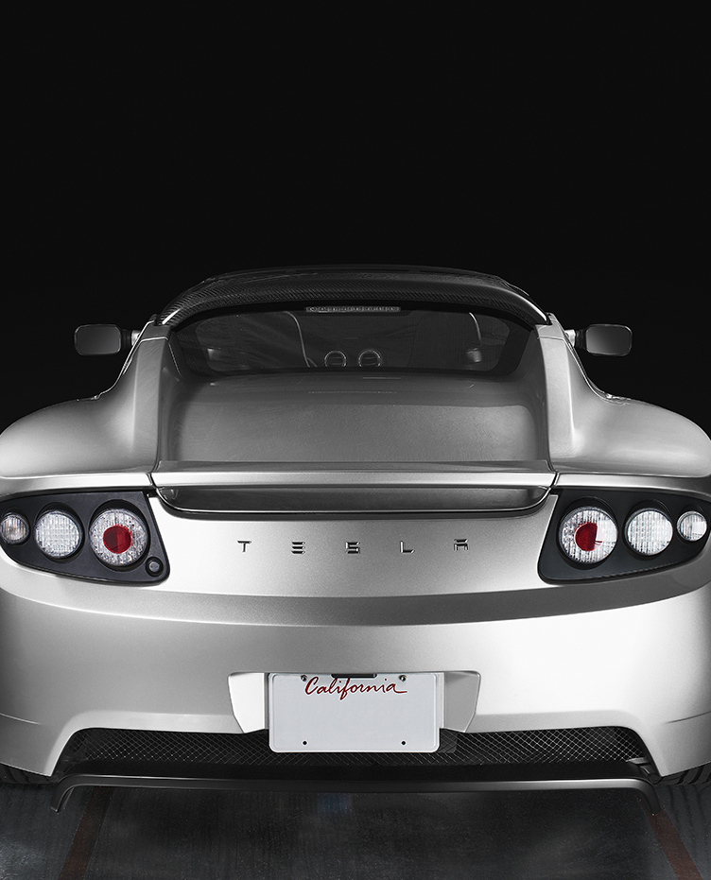

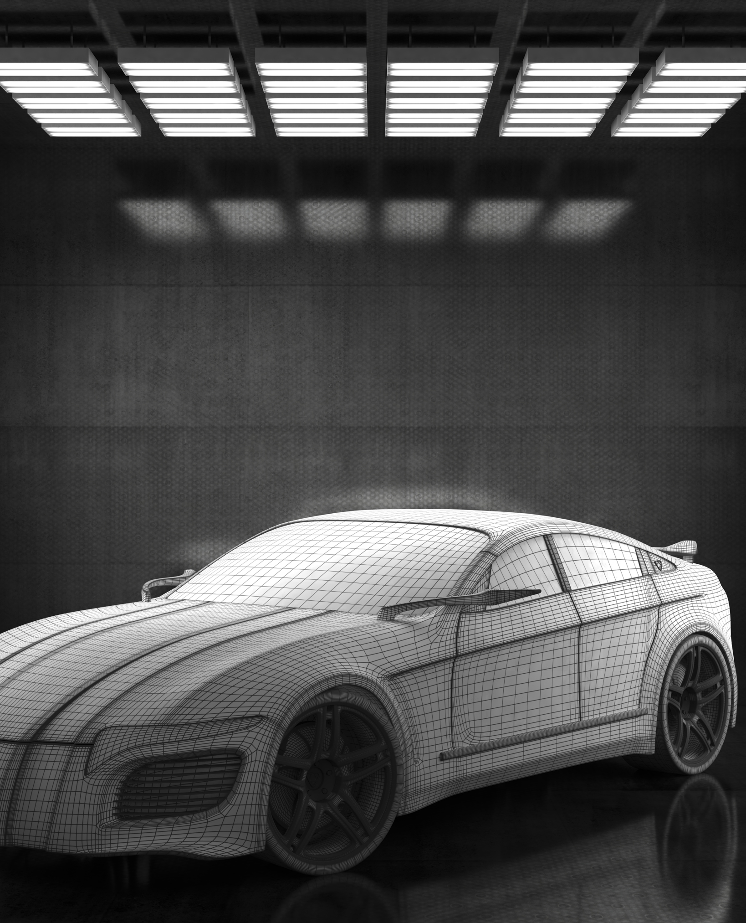
Group Approach
Describe the source of your data and why you chose it for your project. Describe the collection, exploration, and cleanup process.
Describe the source of your data and why you chose it for your project. Describe the collection, exploration, and cleanup process.
Include any relevant code or demonstrations of the application or analysis.
Discuss any unanticipated insights or problems that arose and how you resolved them.

Slide 4
Overview of Data Collection, Cleanup, and Exploration Process
Data Collection
We began looking at datasets for baseball, but we couldn’t find any that worked. So, we found the vehicle data set, and it was a relevant topic, since some of us had been researching for new vehicles.
Exploration
As we looked at the data, we realized we needed to add the Census 2020 data to be able to answer our proposed questions.
Cleanup
Both the vehicle dataset and the Census dataset had to be cleaned, and new rows with new information had to be added to both data sets for the analysis.
Analysis
Conclusion
From the Analysis, our findings are…
The Notes pane is a box that appears below each slide. Tap it to add notes.

Slide 5

Analysis Results
Subtitle

Slide 6
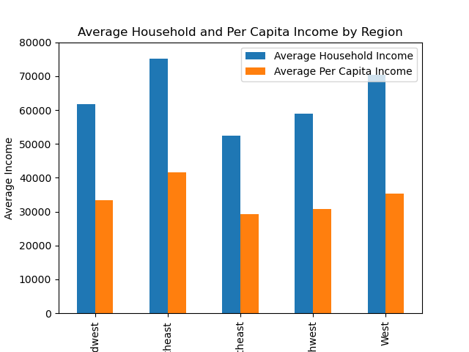
Average income by region

Slide 7
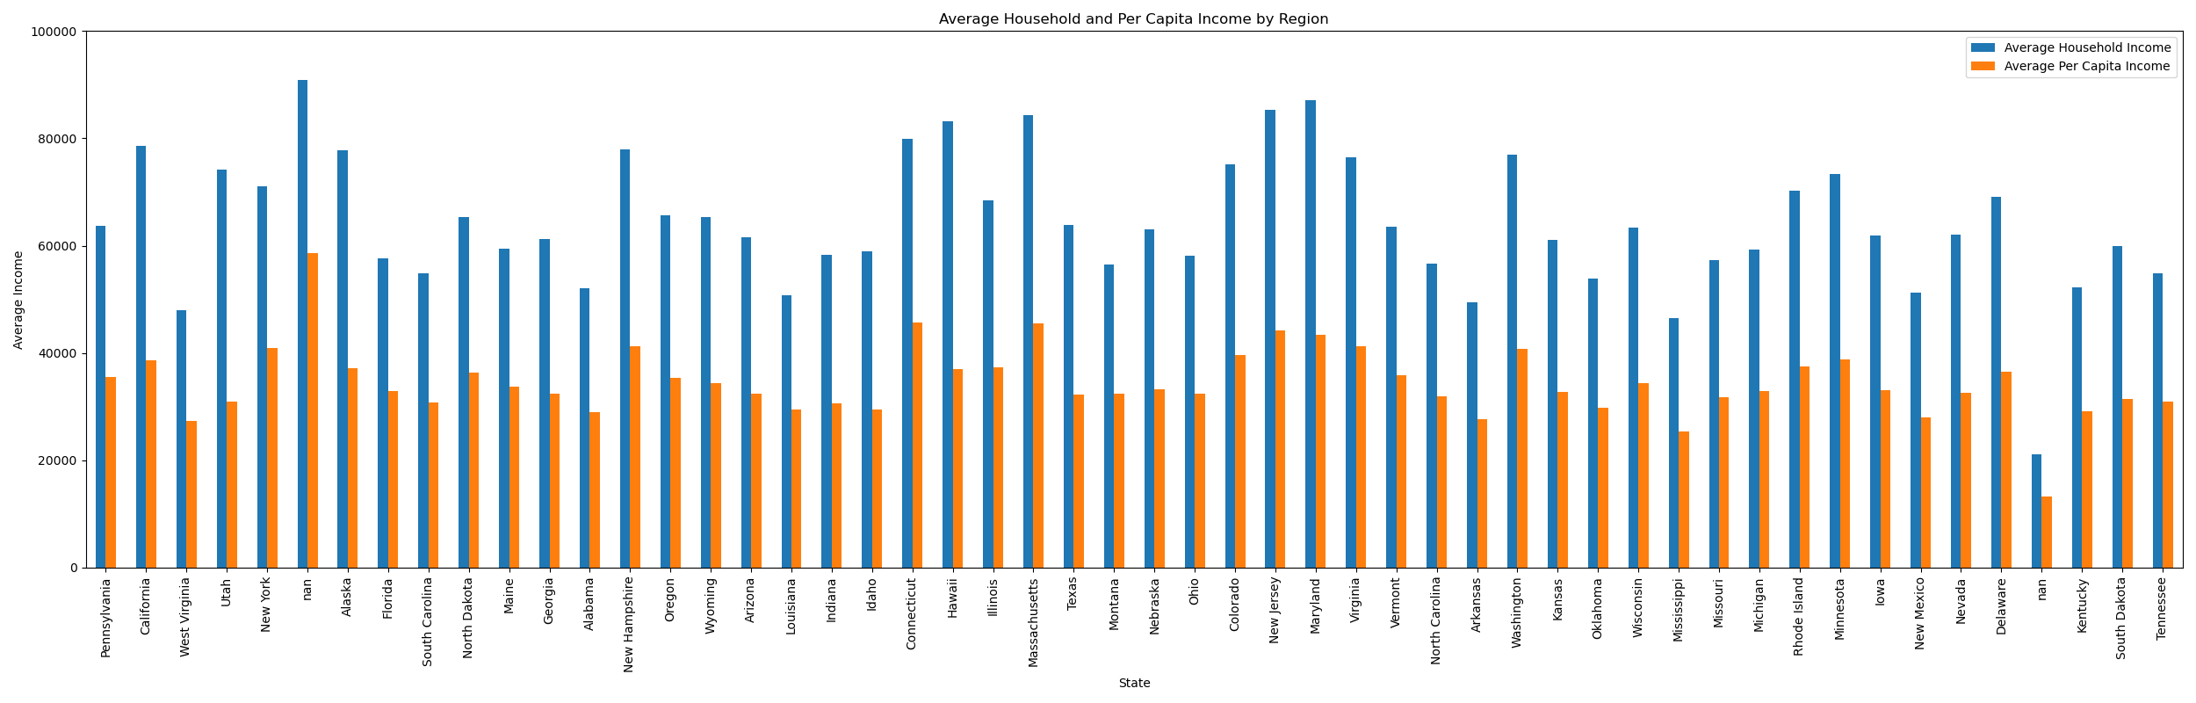
Average income by state

Slide 8
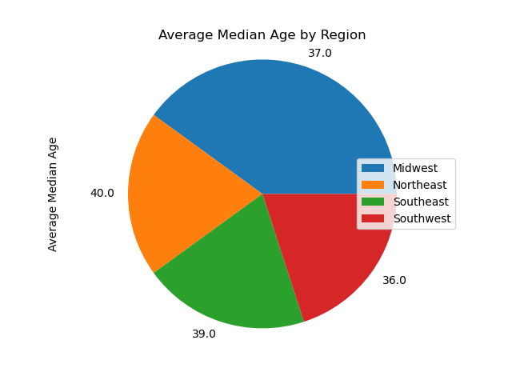
Average median age by region
Walt Disney

Slide 13
Table
 | Category 1 | Category 2 | Category 3 | Category 4
Item 1 | 4.5 | 2.3 | 1.7 | 5
Item 2 | 3.2 | 5.1 | 4.4 | 3
Item 3 | 2.1 | 1.7 | 2.5 | 2.8
Item 4 | 4.5 | 2.2 | 1.7 | 7

Slide 14
Content 2
Subtitle
subtitle
subtitle
Add text, images, art, and videos.
Add transitions, animations, and motion.
Save to OneDrive, to get to your presentations from your computer, tablet, or phone.
Open the Design Ideas pane for instant slide makeovers.
When we have design ideas, we’ll show them to you right there.
Add text, images, art, and videos.
Add transitions, animations, and motion.
Save to OneDrive, to get to your presentations from your computer, tablet, or phone.
Open the Design Ideas pane for instant slide makeovers.
When we have design ideas, we’ll show them to you right there.
Add text, images, art, and videos.
Add transitions, animations, and motion.
Save to OneDrive, to get to your presentations from your computer, tablet, or phone.
Open the Design Ideas pane for instant slide makeovers.
When we have design ideas, we’ll show them to you right there.

Slide 15

Conclusion
With PowerPoint, you can create presentations and share your work with others, wherever they are. Type the text you want here to get started. You can also add images, art, and videos on this template. Save to OneDrive and access your presentations from your computer, tablet, or phone.

Slide 16

Next Steps
Subtitle
Add text, images, art, and videos.
Add transitions, animations, and motion.
Save to OneDrive, to get to your presentations from your computer, tablet, or phone.
Subtitle
Open the Design Ideas pane for instant slide makeovers.
When we have design ideas, we’ll show them to you right there.

